Slide 3
https://en.wikipedia.org/wiki/Hawaii_Children's_Discovery_Center#/media/File:USA_Hawaii_location_map.svg
Map-of-Hawaii-4.gif (1412×1062) (fotolip.com) HAWAII-MAP-color-1-1024x755.jpeg (1024×755) (mapofthemonth.com)
https://en.wikipedia.org/wiki/List_of_islands_of_Hawaii
https://en.wikipedia.org/wiki/Lei_Day
https://travelperi.com/hawaiian-islands-map/
https://www.punahou.edu/life-at-punahou/traditions/may-day-and-holoku
https://www.pbs.org/wnet/americanmasters/what-are-the-eight-island https://www.homeyhawaii.com/blog/culture/official-colors-and-flowers-of-hawaiian-islands/

Slide 4
“May Day is Lei Day” Item Descriptions and Lesson Plan Ideas
All activities offer a choice
of color or blackline
clipart. Map Skills: Two map choices are provided as a reference to match the names of the Islands based on the age of your kiddos and your kiddos’ map skill levels. 41 Vocabulary Cards: Use the vocabulary cards to introduce the topic. Print (I recommend Colored Cardstock), laminate (you’ll be glad you did later ;)), then cut (nice evening job for the working Mom/Dad that wants to help and feel a part of things.) Place cards in a pocket chart or in view of the students, read through, and discuss what the topic could be about. For your ELL Kiddos or to increase comprehension of all kiddos, considered adding pictures clues to the Vocabulary cards. Another option to have more room the word is to glue the card to sentence strips, then add the pictures clues. Copy the cards at 50% or 25% for the kiddos to add to their journals.
ABC Order: There are three options: 6 words, 8 words, or 16 words. Each of the options comes in either color or grayscale. The recording sheets have two writing options: traditional (headline, midline, & baseline) or the one-line format. As an introduction to the activity, you can put an assortment of vocabulary cards in a pocket chart or magnetic board. Organize the cards in alphabetical order as a group, giving some kiddos extra practice time or time to build confidence in their skills. If alphabetizing is a new or unmastered skill for the kiddos, place cards at the workstation for the kiddos to organize and then record, “Self-Check” cards are provided when you just can’t think of grading another thing!
©2024PenguinEducationalIceberg.Com

Slide 5
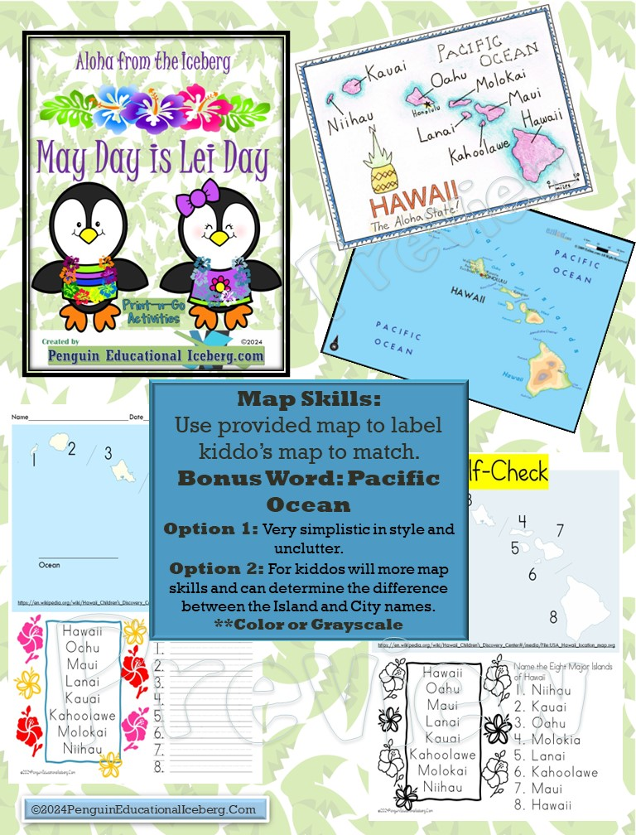

Slide 7
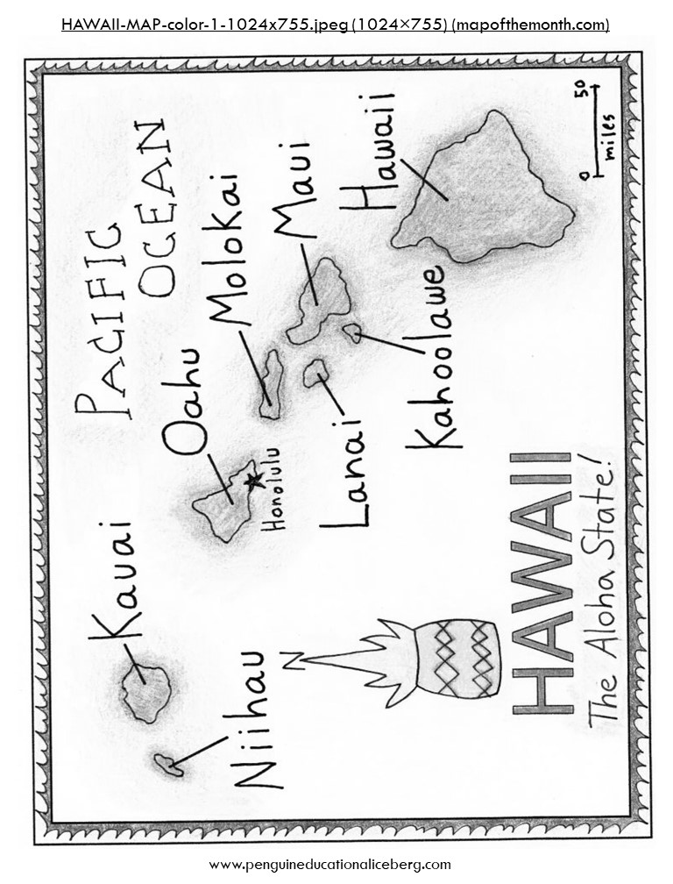

Slide 8
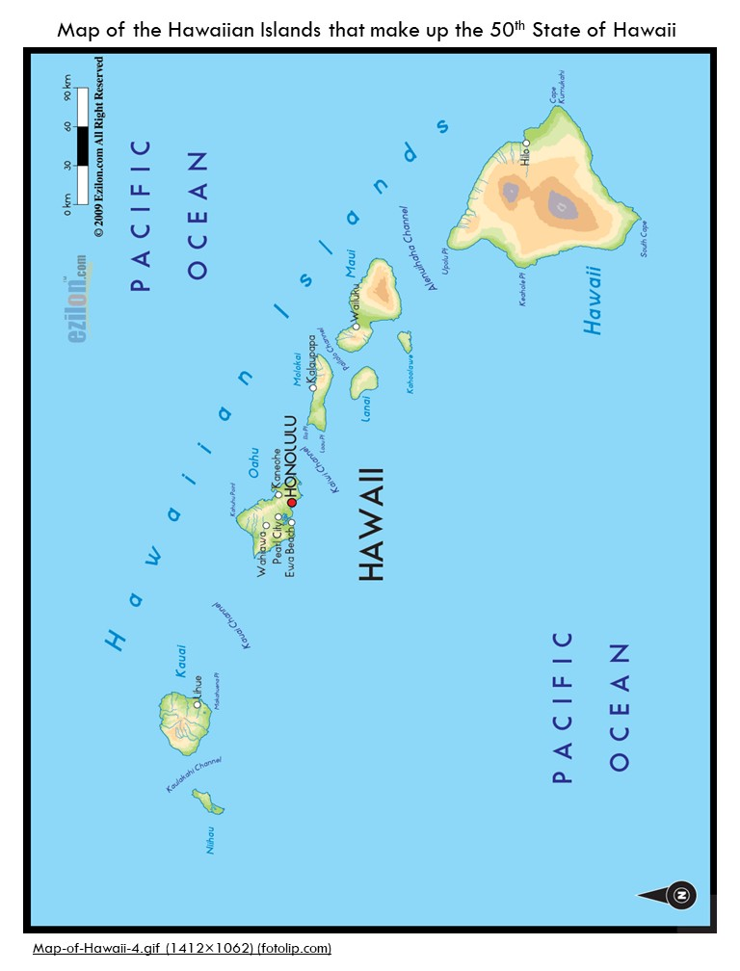

Slide 9
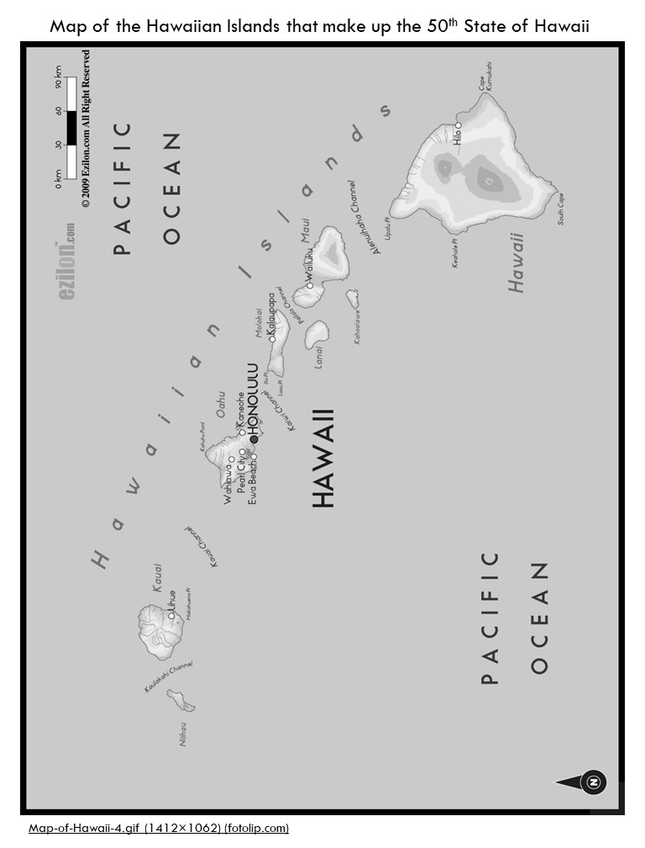

Slide 10
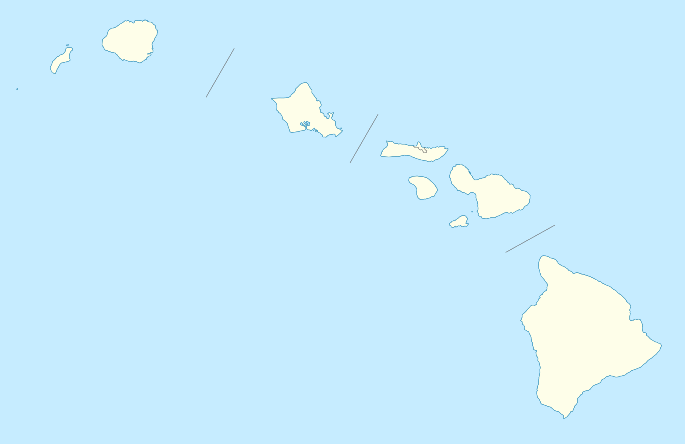
Name____________________________ Date_________________________________
2
3
1
4
7
5
6
____________________ Ocean
8
https://en.wikipedia.org/wiki/Hawaii_Children's_Discovery_Center#/media/File:USA_Hawaii_location_map.svg
Hawaii Oahu
Maui Lanai
Kauai Kahoolawe Molokai Niihau
Name the Eight Major Islands of Hawaii 1. ///////////// 2. ///////////// 3. /////////////
4. ///////////// 5. ///////////// 6. /////////////
7. /////////////
8. /////////////
©2024PenguinEducationalIceberg.Com

Slide 11
Name____________________________ Date_________________________________
2
3
1
4
7
5
6
____________________ Ocean
8
https://en.wikipedia.org/wiki/Hawaii_Children's_Discovery_Center#/media/File:USA_Hawaii_location_map.svg
Hawaii Oahu
Maui Lanai
Kauai Kahoolawe Molokai Niihau
Name the Eight Major Islands of Hawaii 1. ///////////// 2. ///////////// 3. /////////////
4. ///////////// 5. ///////////// 6. /////////////
7. /////////////
8. /////////////
©2024PenguinEducationalIceberg.Com

Slide 12
Name____________________________ Date_________________________________
2
3
1
4
7
5
6
____________________ Ocean
8
https://en.wikipedia.org/wiki/Hawaii_Children's_Discovery_Center#/media/File:USA_Hawaii_location_map.svg
Hawaii Oahu
Maui Lanai
Kauai Kahoolawe Molokai Niihau
Name the Eight Major Islands of Hawaii 1. ______________ 2. ______________ 3. ______________
4. ______________ 5. ______________ 6. ______________
7. ______________
8. ______________
©2024PenguinEducationalIceberg.Com

Slide 13
Name____________________________ Date_________________________________
2
3
1
4
7
5
6
____________________ Ocean
8
https://en.wikipedia.org/wiki/Hawaii_Children's_Discovery_Center#/media/File:USA_Hawaii_location_map.svg
Name the Eight Major Islands of Hawaii 1. ______________ 2. ______________ 3. ______________
4. ______________ 5. ______________ 6. ______________
7. ______________
8. ______________
Hawaii Oahu
Maui Lanai
Kauai Kahoolawe Molokai Niihau
©2024PenguinEducationalIceberg.Com

Slide 14
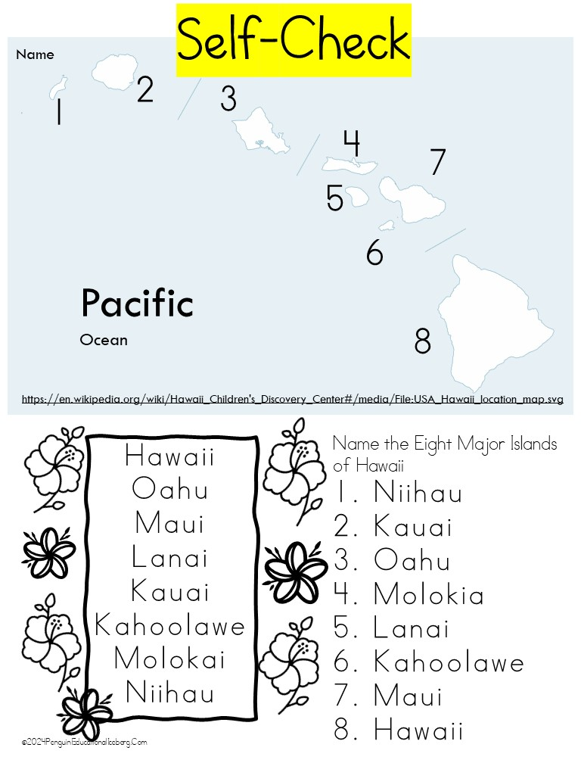

Slide 15
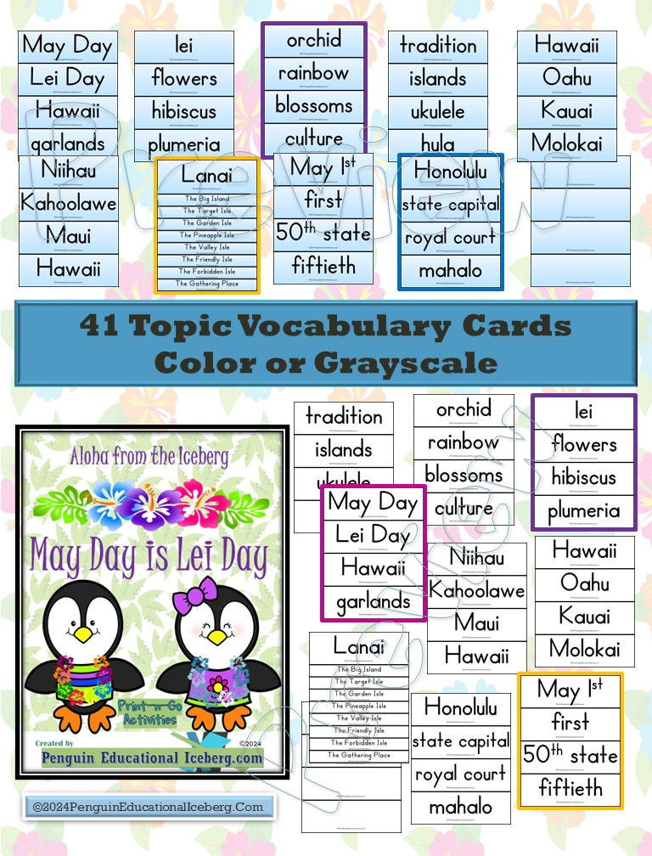

Slide 16
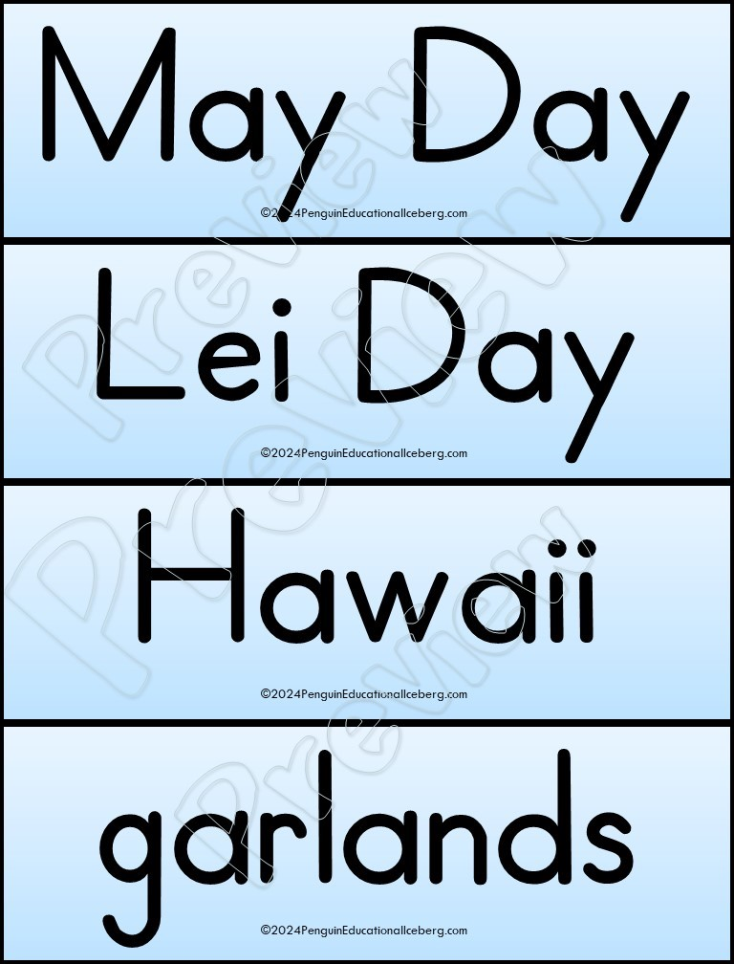

Slide 17
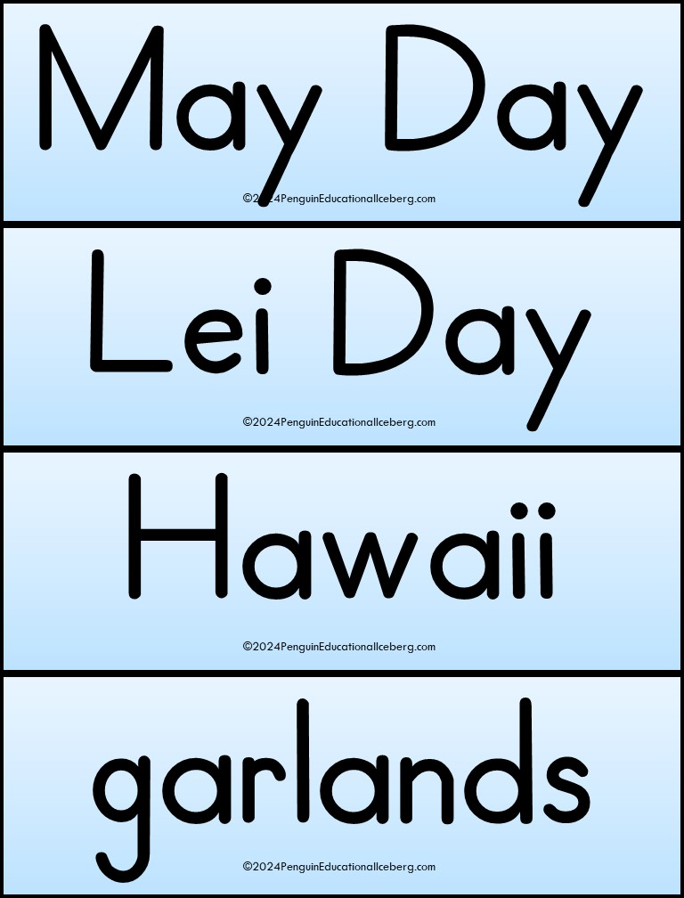

Slide 18
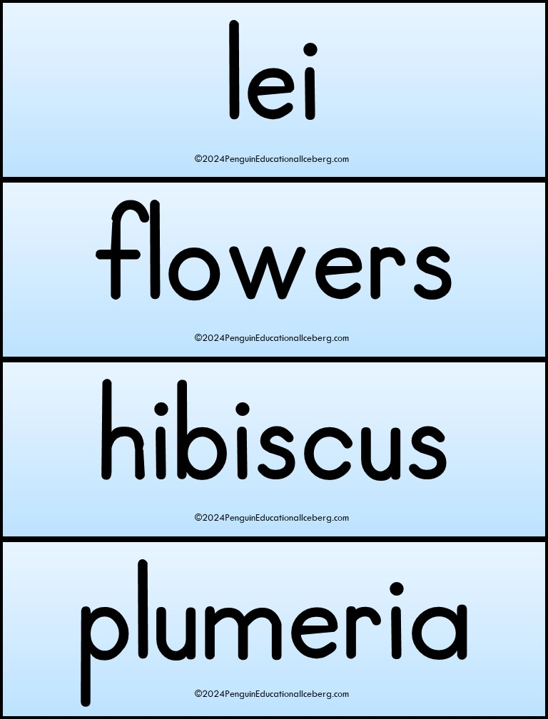

Slide 19
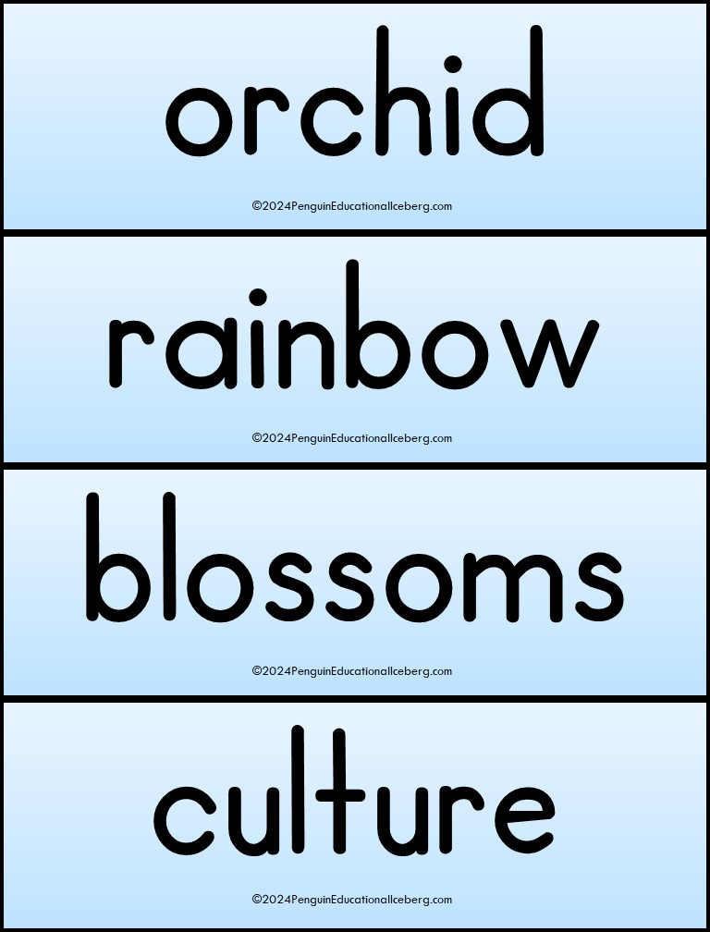

Slide 20
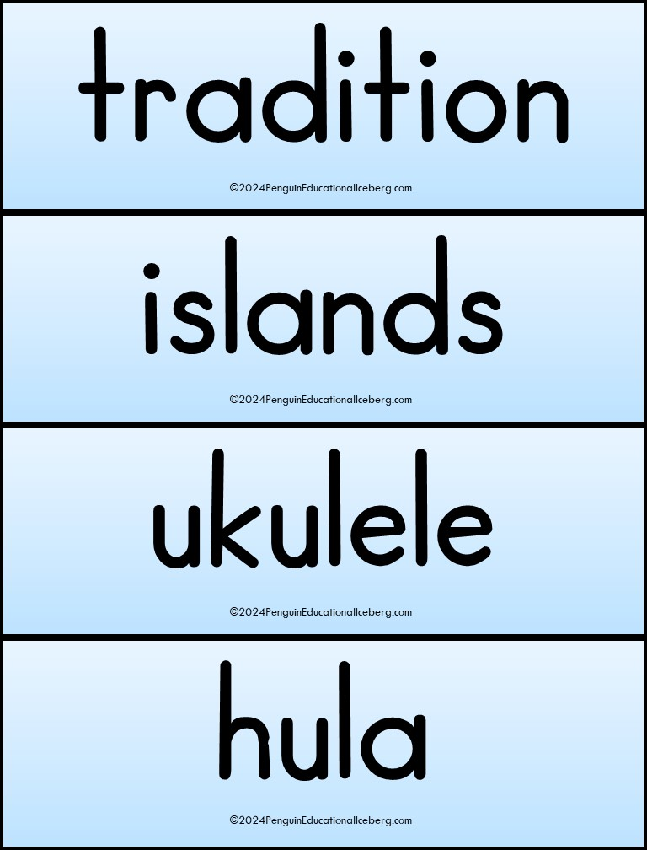

Slide 21
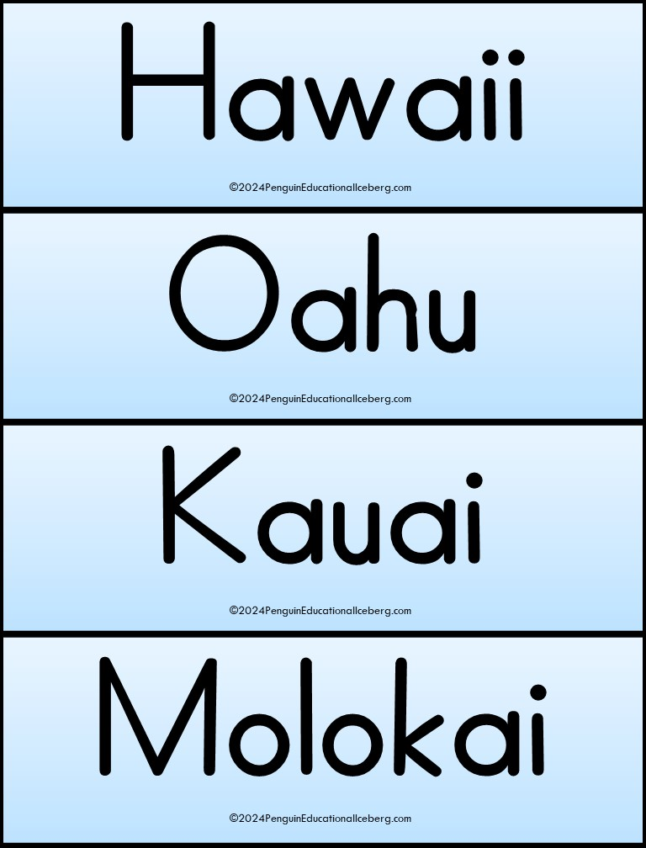

Slide 22
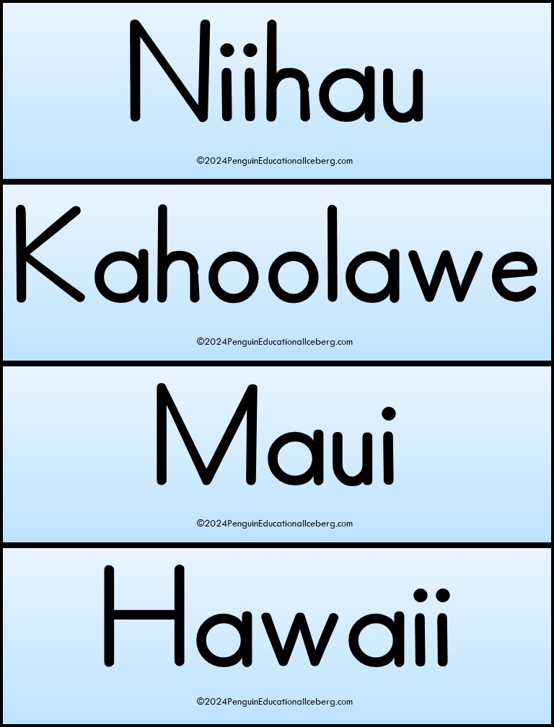

Slide 23
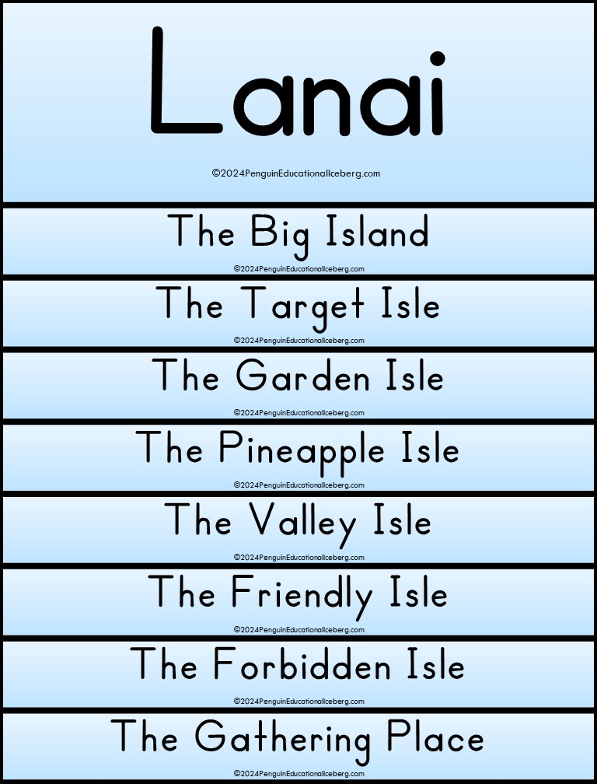

Slide 24
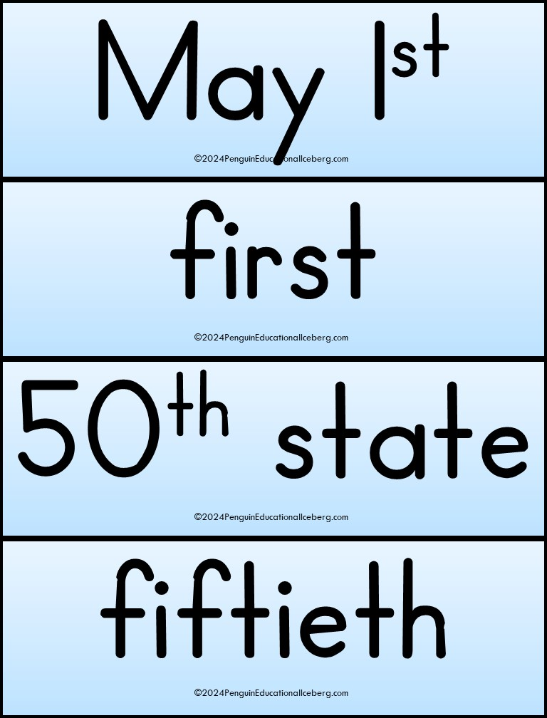

Slide 25
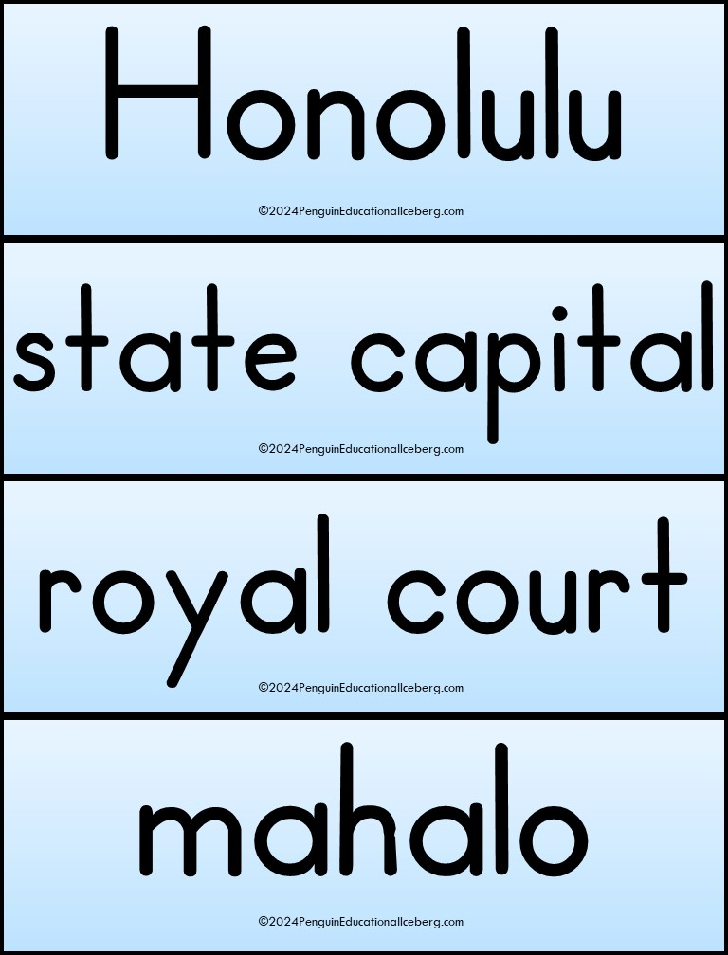

Slide 26
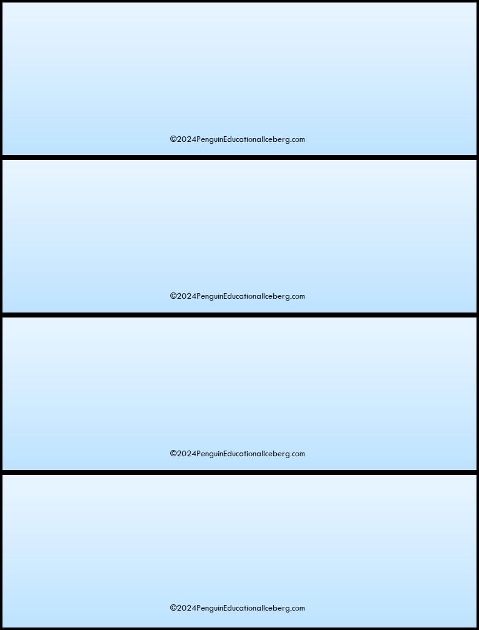

Slide 27
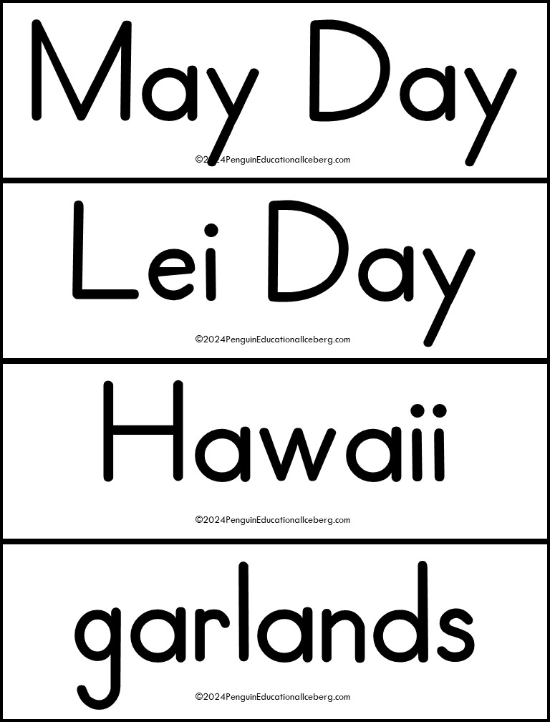

Slide 28
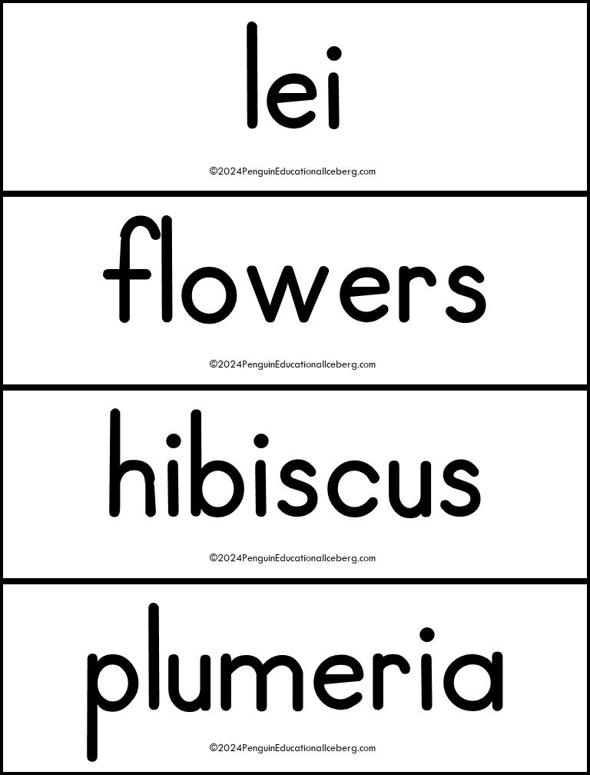

Slide 29
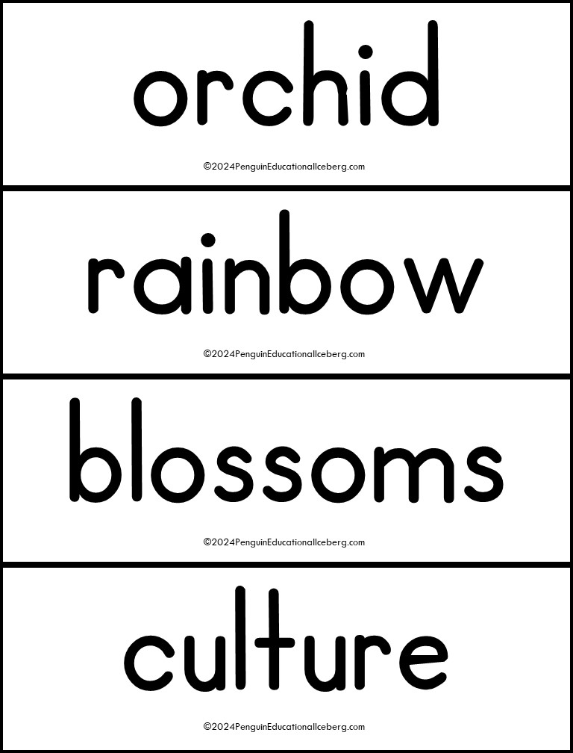

Slide 30
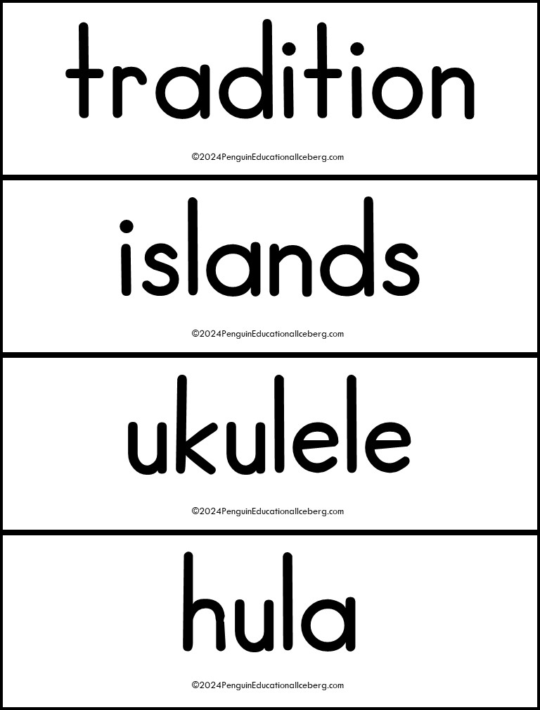

Slide 31
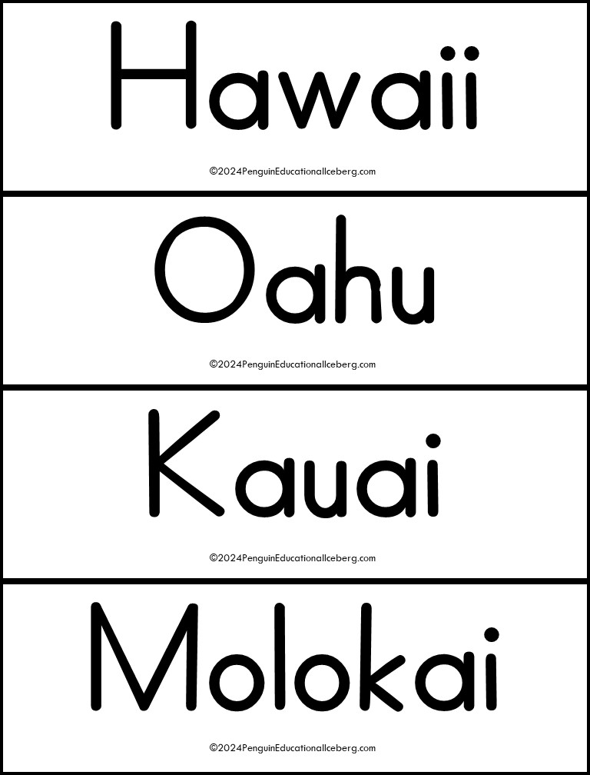

Slide 32
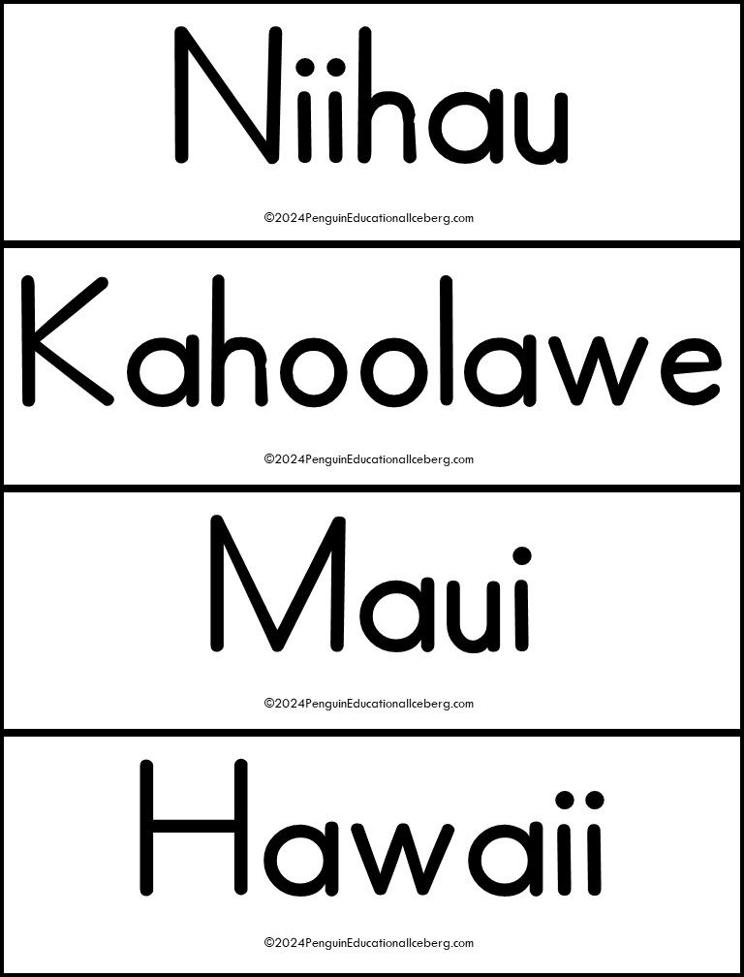

Slide 33
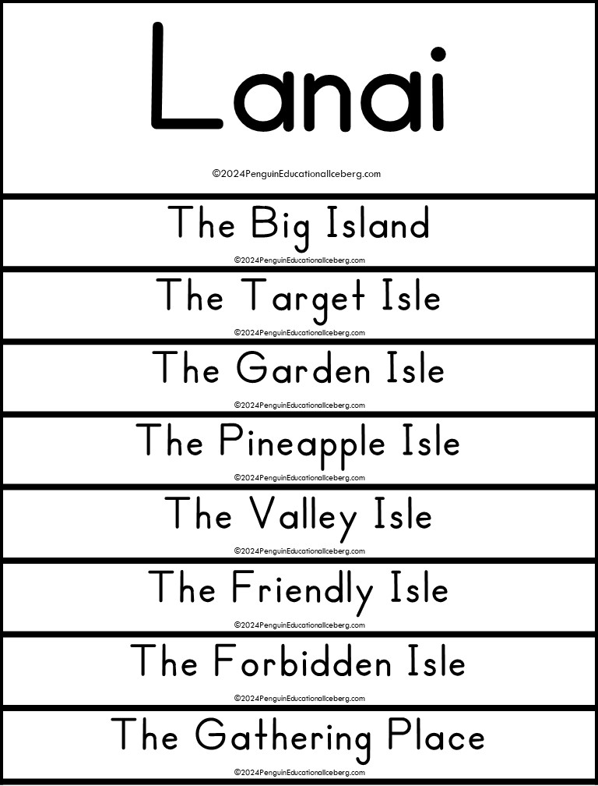

Slide 34
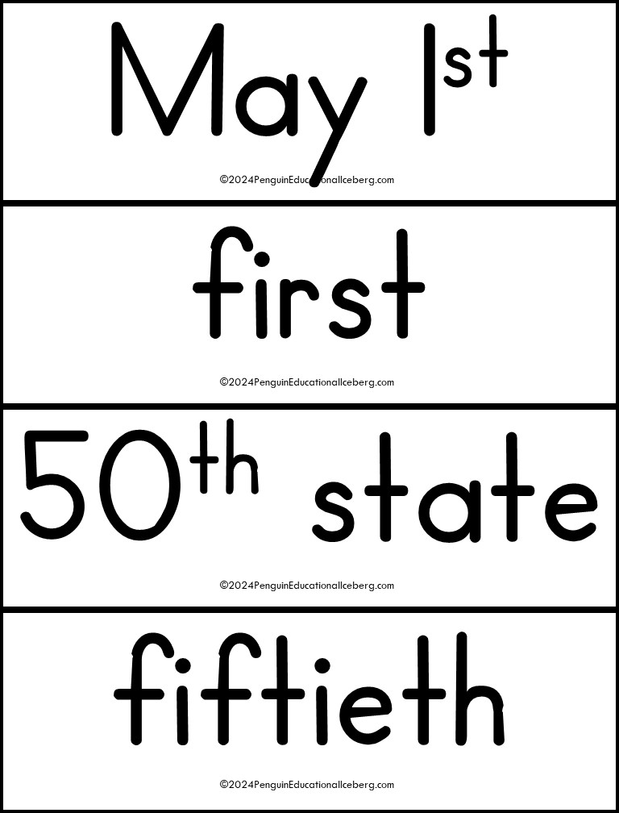

Slide 35
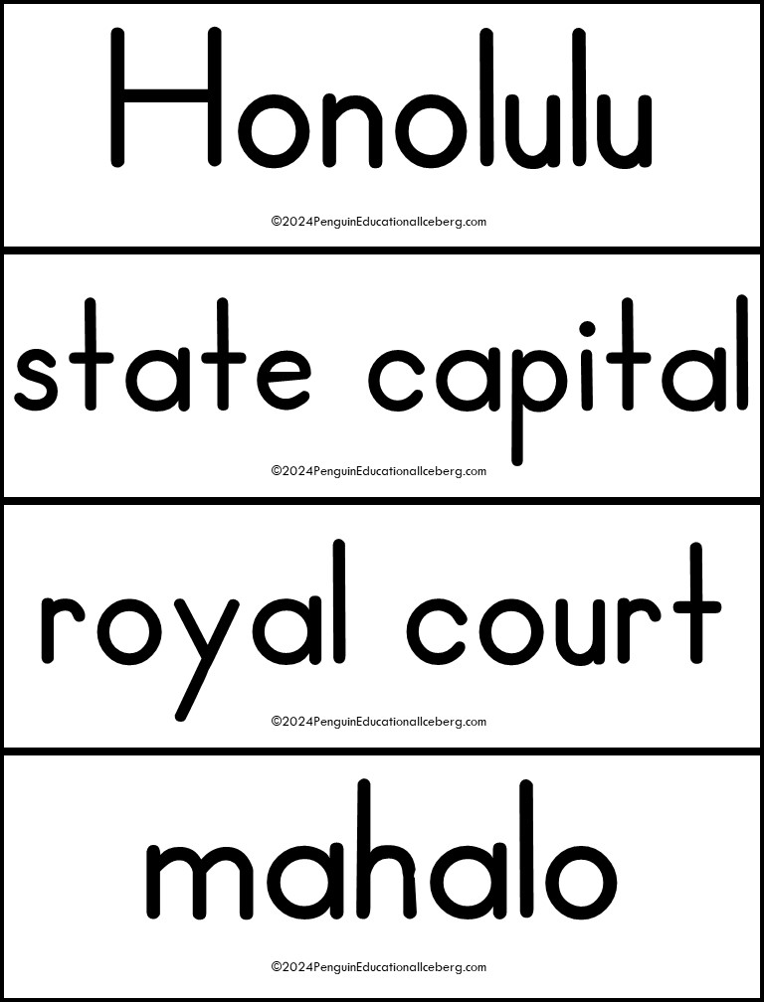

Slide 37
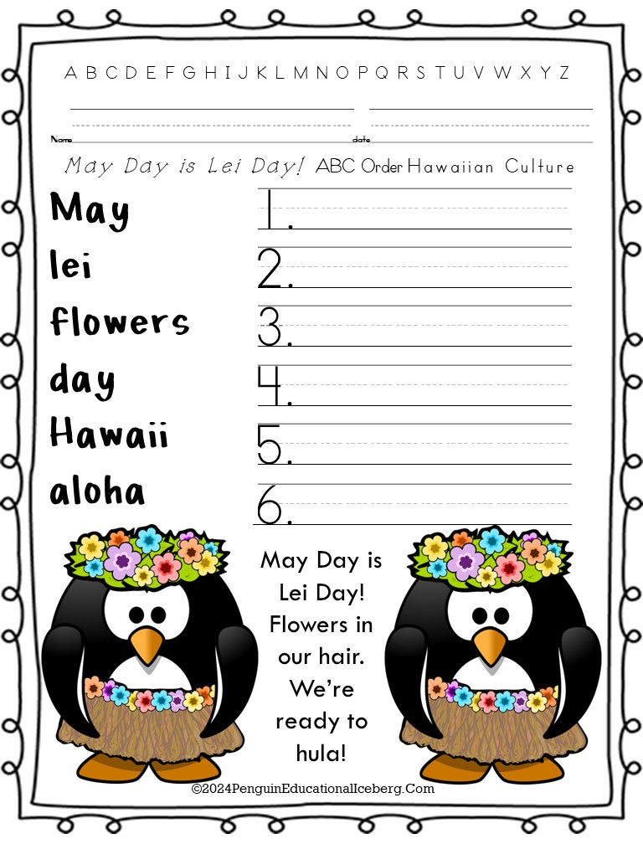
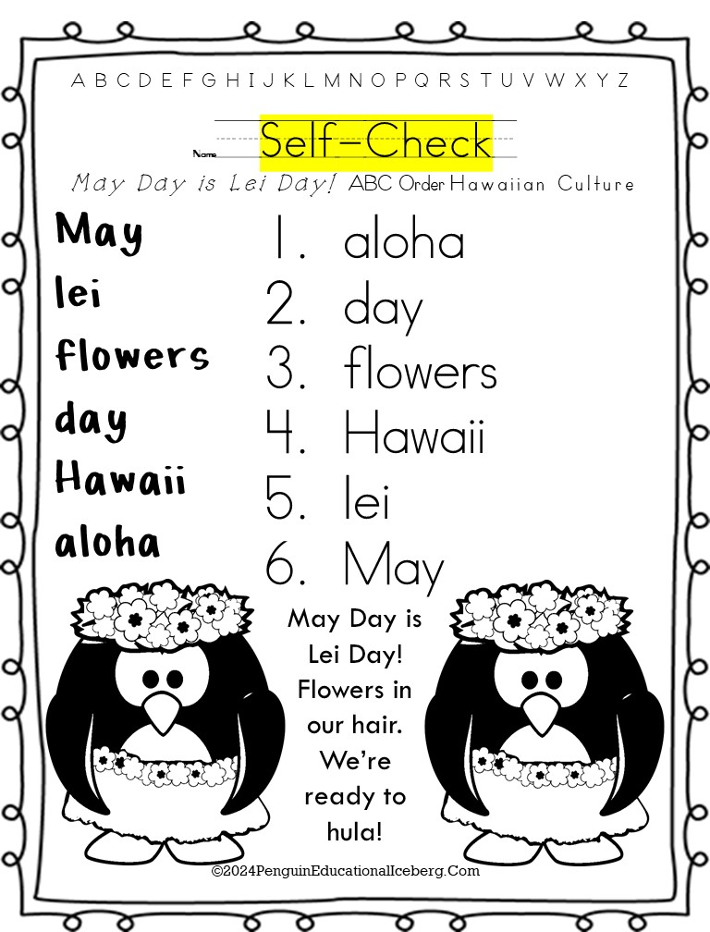
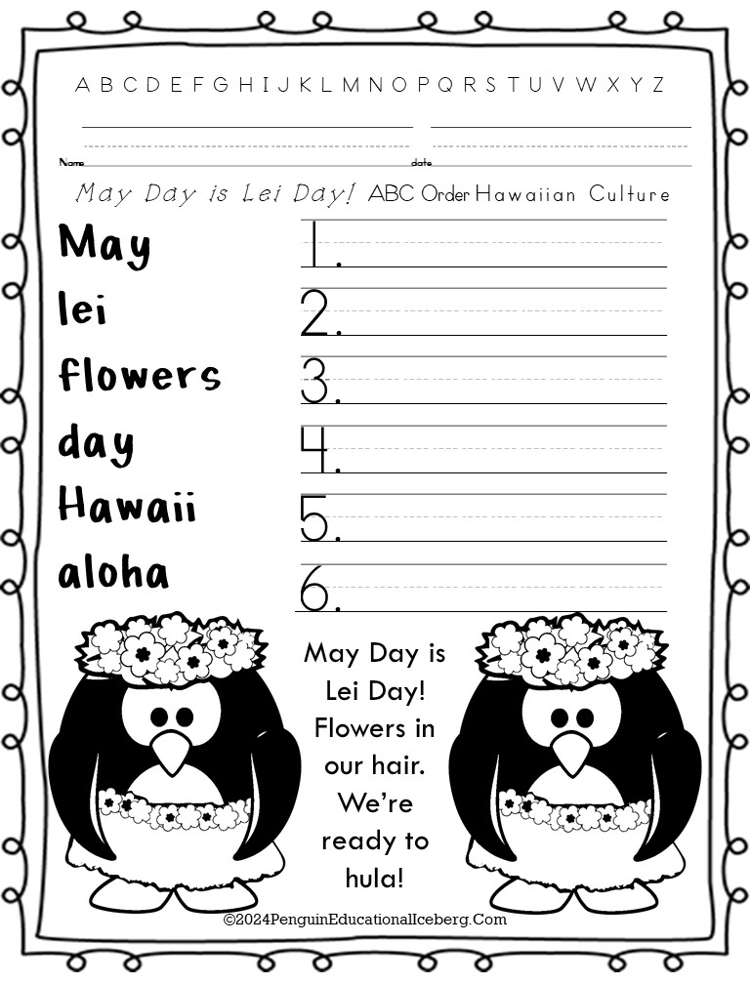
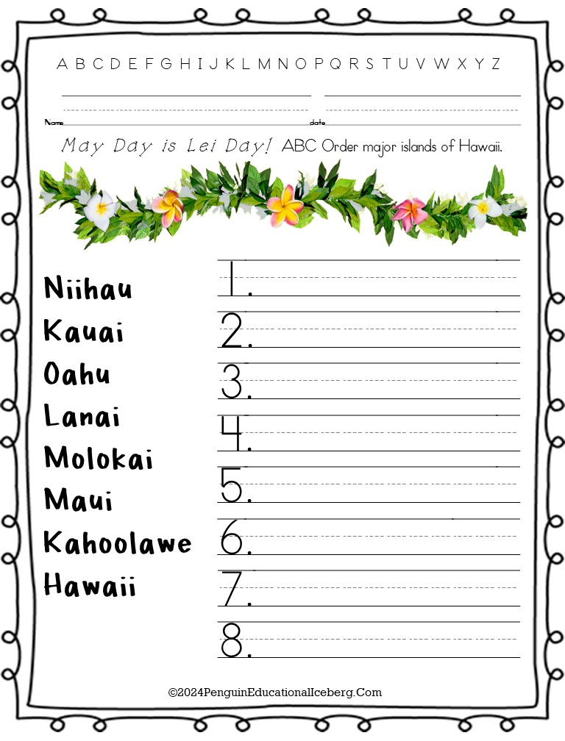
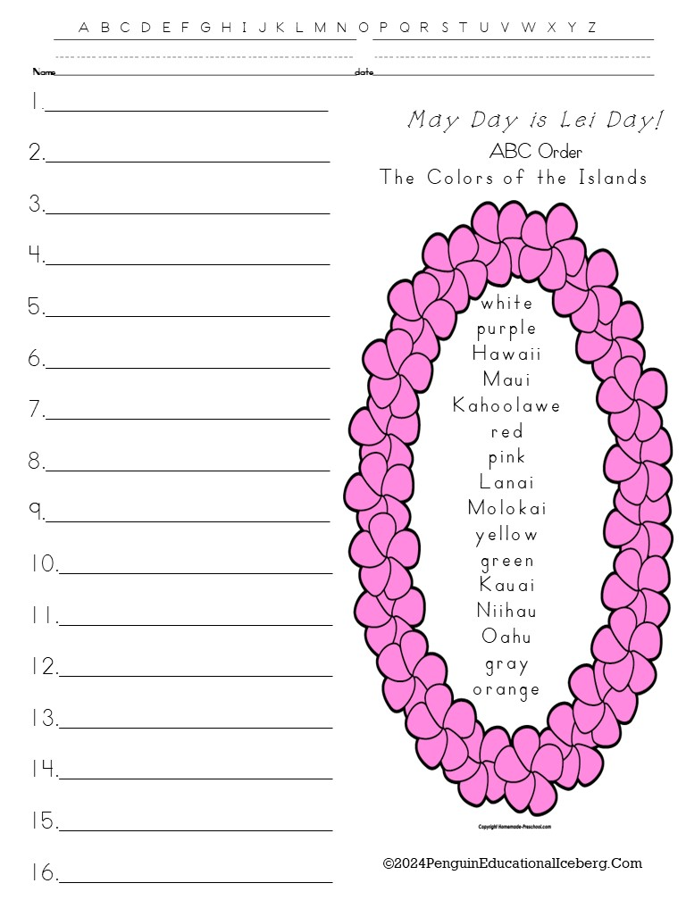
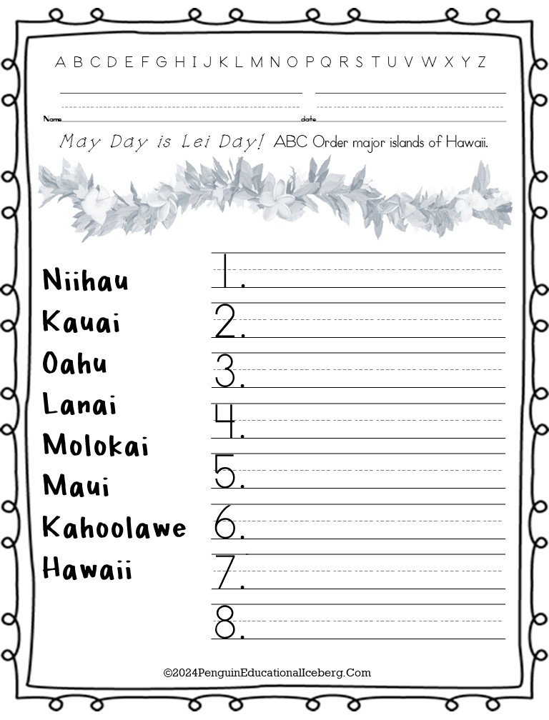
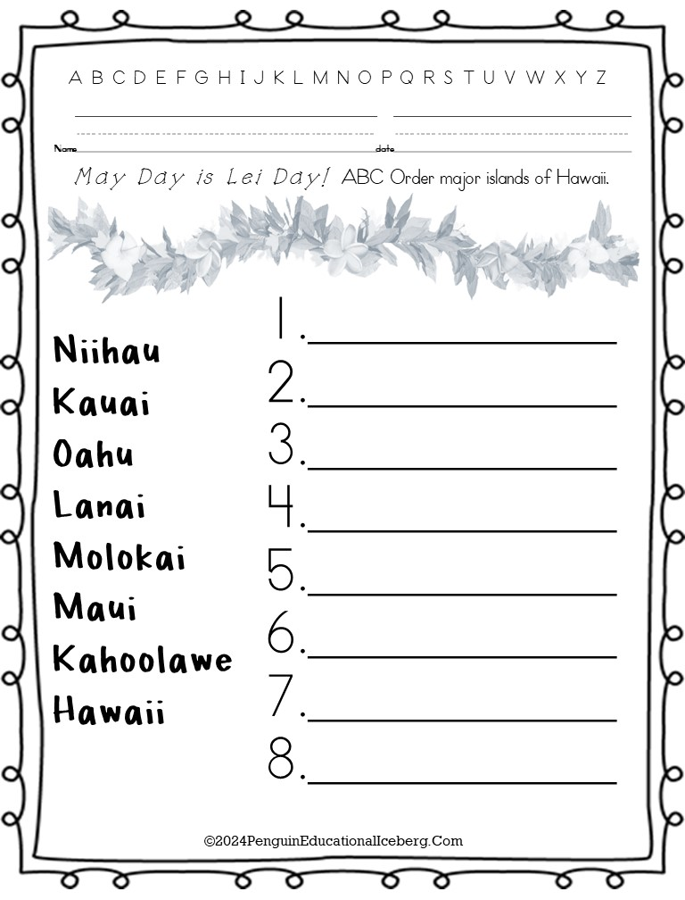
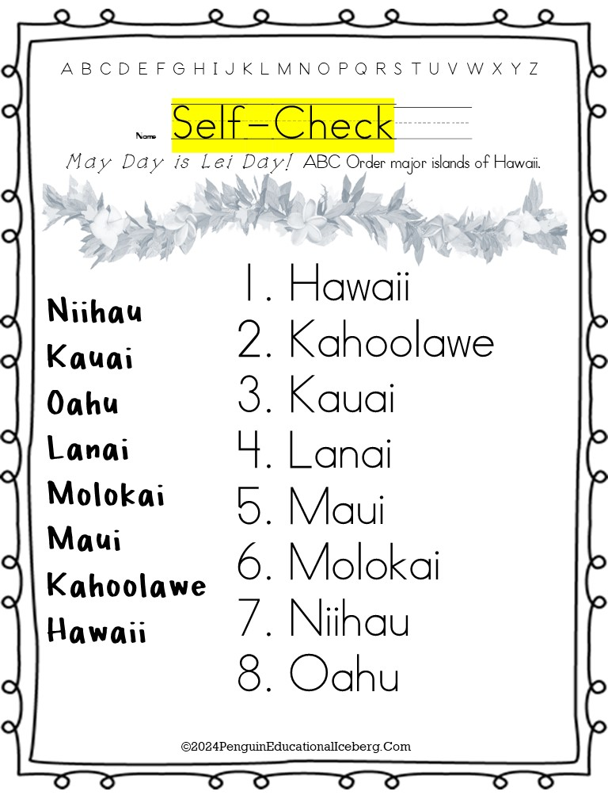
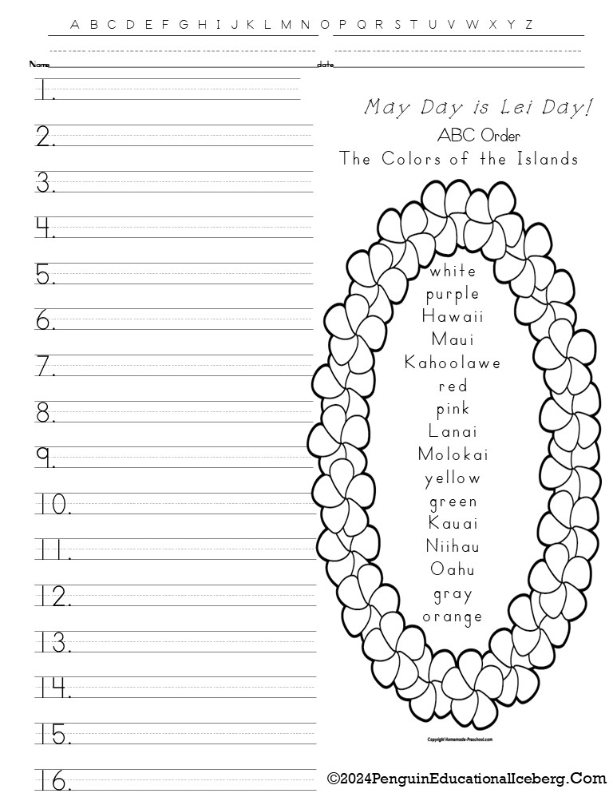
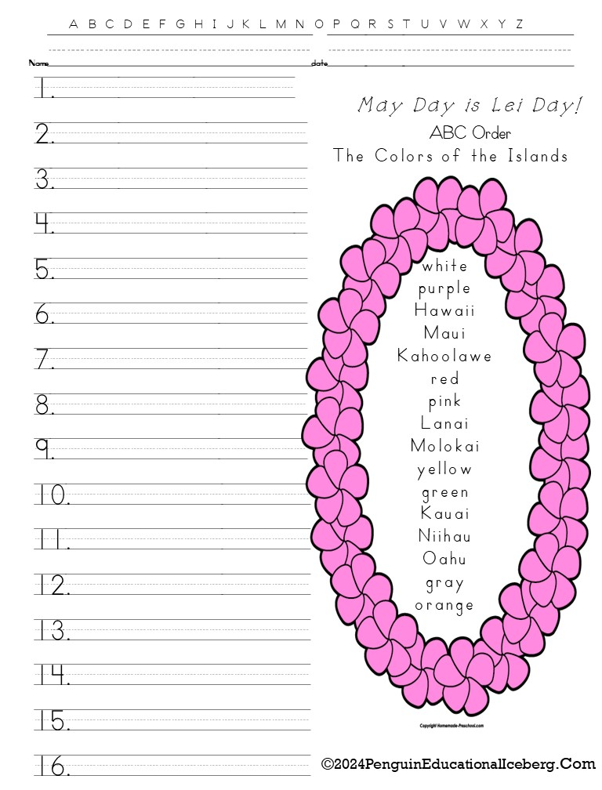
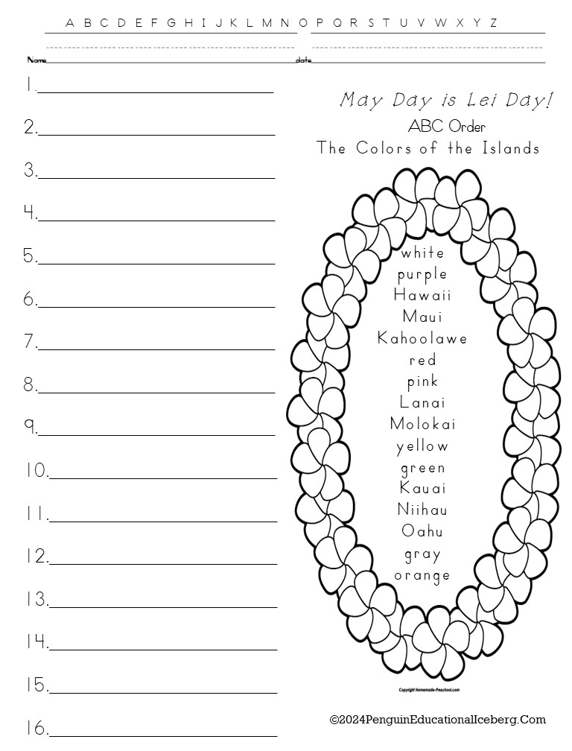
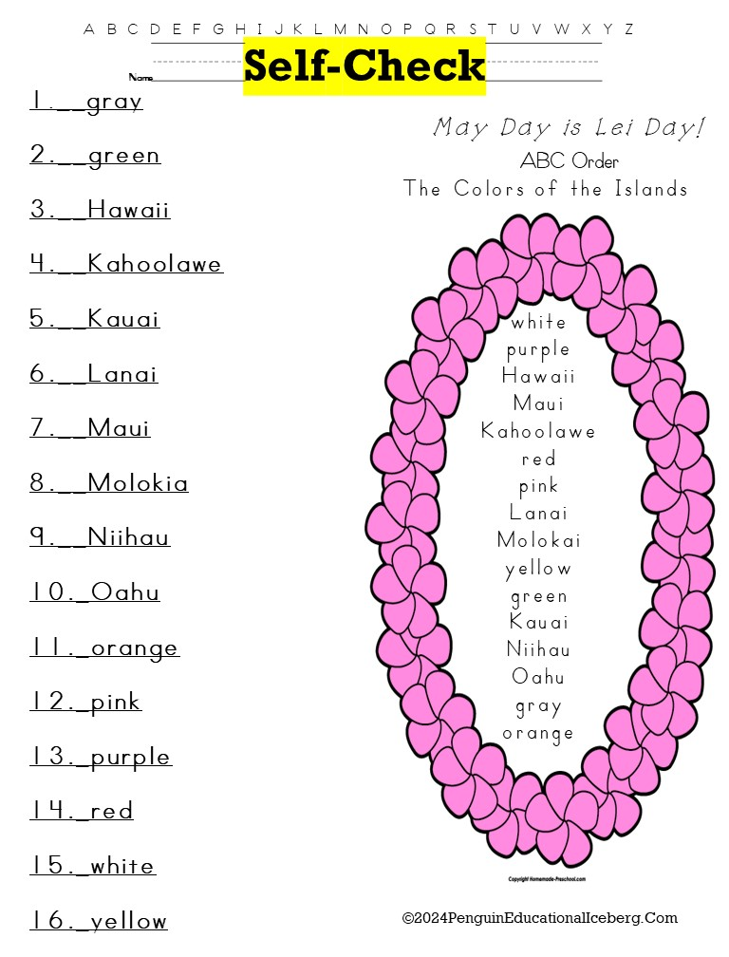
Preview
Preview
A, B,C Order 3 versions with 6, 8, or 16 words **Optional Writing Lines **Self-Check Cards **Color or Grayscale
©2024PenguinEducationalIceberg.Com

Slide 38
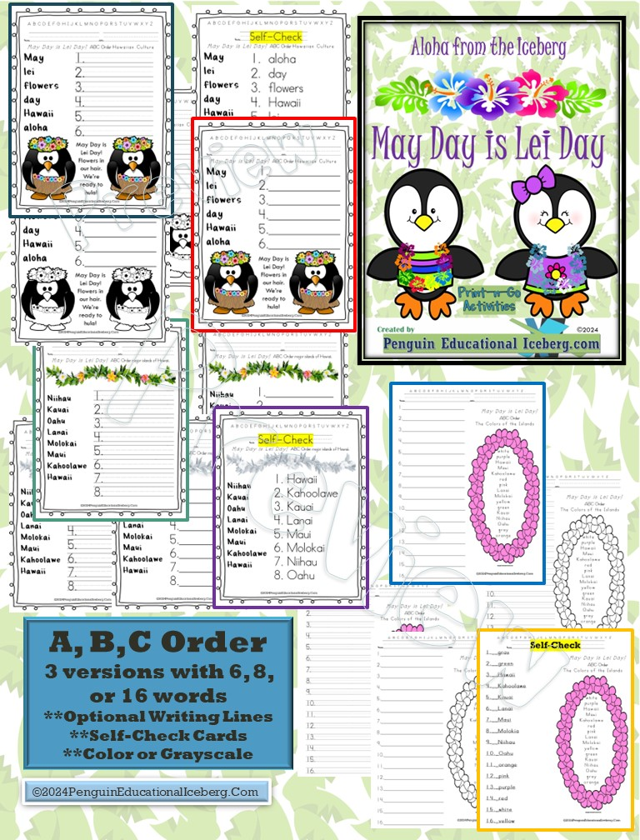

Slide 50
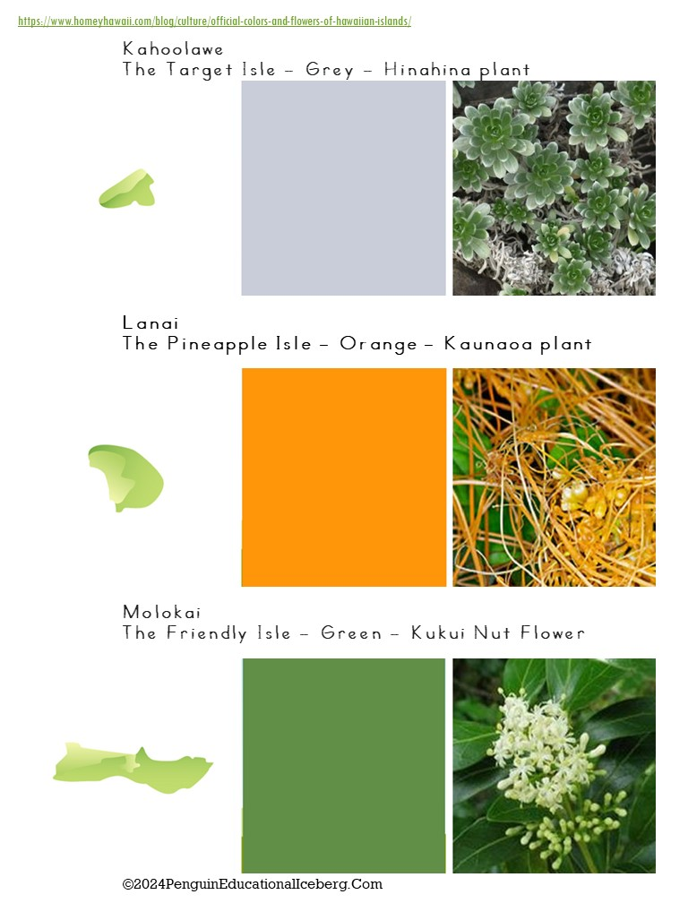

Slide 51
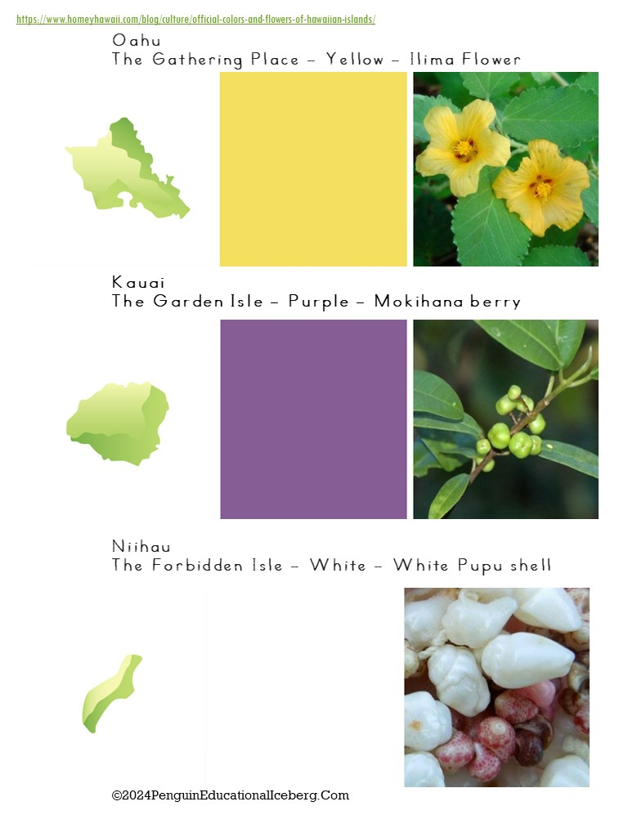

Slide 57
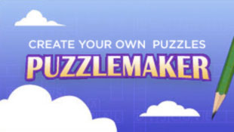
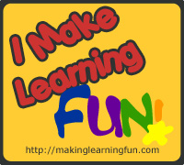
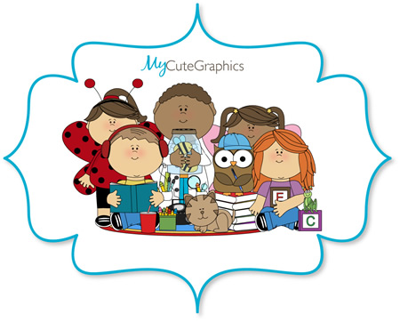
Special Thanks to …
You: for purchasing ☺
Making Learning Fun: for the K. Wilson Character drawings
FREE Page border and Veterans
Discovery Puzzlemaker: design word searches
Fonts4Teachers: Abc print, Abc lined
Kevin and Amanda: fonts
Just So Scrappy: backgrounds, fonts
Lettering Delights: backgrounds, frames, fonts
My Cute Graphics: animals, kiddos
Whimsy Clips : animals, kiddos
Zip-A-Dee Doo-Dah Designs: families
©2024PenguinEducationalIceberg.Com

